Slide 1






Foundations of
Quantum Information Science (QIS 102)
Dave Biersach
Brookhaven National Laboratory
dbiersach@bnl.gov
Session 17
Differential Equations

Slide 2
Session 17 – Part 1 of 2 – Topics
Simulate the trajectory of a circus cannon performer
Implement Euler’s Method for finding numerical solutions to physical laws represented as differential equations
Obtain Euler’s Method from Fermat's definition of the derivative
Model the radioactive decay of Carbon-14 and Fluorine-18
Use Euler’s Method to model the simple harmonic motion of a single (unforced, undamped) pendulum
Appreciate the importance of stability in numerical solutions by implementing Cromer’s fix for Euler’s method that eliminates the possible artificial energy gain in the long-term evolution of an oscillatory system

Slide 3
Session 17 – Part 1 of 2 – Topics
Numerically estimate the solution to a non-linear differential equation using the Runge-Kutta method
Estimate numerical solutions to ordinary differential equations (ODEs) using SciPy
Model the harmonic motion of a simple pendulum using SciPy
Model a damped oscillator to appreciate the impact of critical damping
Analyze the long-term behavior of a harmonograph
Model the Newtonian Kinematics of an Estes Model Rocket through lift-off, where the system mass decreases as solid motor fuel is burnt to produce thrust

Slide 4
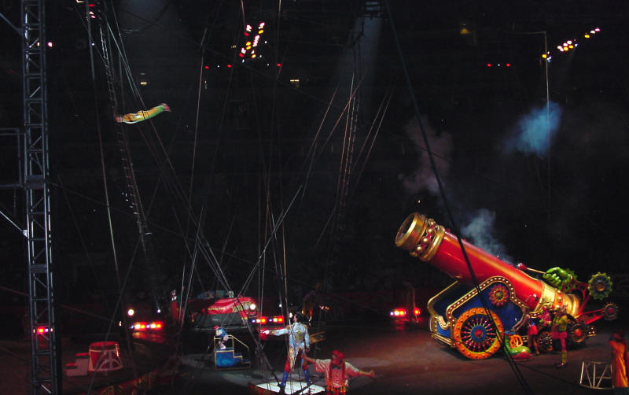
Projectile Motion

Slide 5
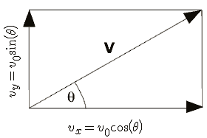
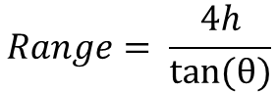
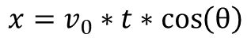
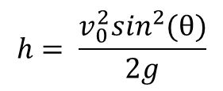
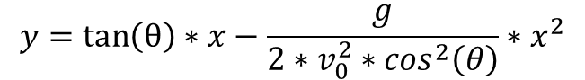
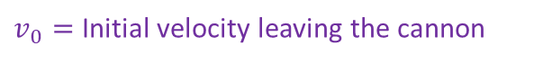
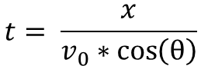
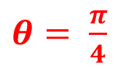
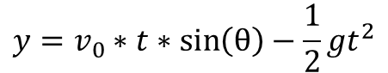
Projectile Motion
$v_{0}=$ Initial velocity leaving the cannon
$$x=v_{0}∗t∗\cos\left(θ\right)$$
$$y=v_{0}∗t∗\sin\left(θ\right)−\frac{1}{2}gt^{2}$$
$θ= \frac{π}{4}$
$$t= \frac{x}{v_{0}∗\cos\left(θ\right)}$$
Given the Range = 30m, what does v₀ need to be?
$$y=\tan\left(θ\right)∗x−\frac{g}{2∗v_{0}^{2}∗\cos^{2}\left(θ\right)}∗x^{2}$$
$$h= \frac{v_{0}^{2}\sin^{2}(θ)}{2g}$$
This is the equation of motion that allows us to plot y as x increases from launch point to trampoline
$$Range= \frac{4h}{tan⁡(θ)}$$

Slide 6
Projectile Motion
$v_{0}=$ Initial velocity leaving the cannon
$$x=v_{0}∗t∗\cos\left(θ\right)$$
$$y=v_{0}∗t∗\sin\left(θ\right)−\frac{1}{2}gt^{2}$$
$θ= \frac{π}{4}$
$$t= \frac{x}{v_{0}∗\cos\left(θ\right)}$$
Given the Range = 30m, what does v₀ need to be?
$$y=\tan\left(θ\right)∗x−\frac{g}{2∗v_{0}^{2}∗\cos^{2}\left(θ\right)}∗x^{2}$$
$$v_{0}=\sqrt{\frac{Range ∗g}{\sin{2θ}}}$$
This is the equation of motion that allows us to plot y as x increases from launch point to trampoline

Slide 7
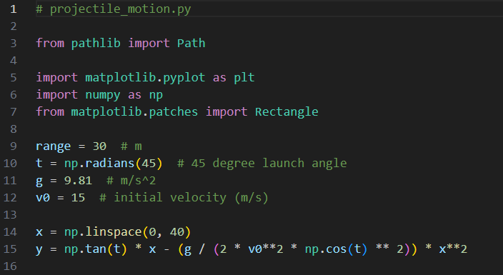
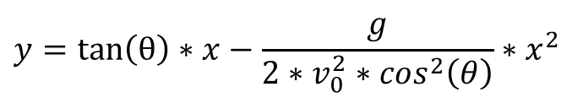
Open projectile_motion.py
①
②
③
④
⑤
⑥

Slide 8
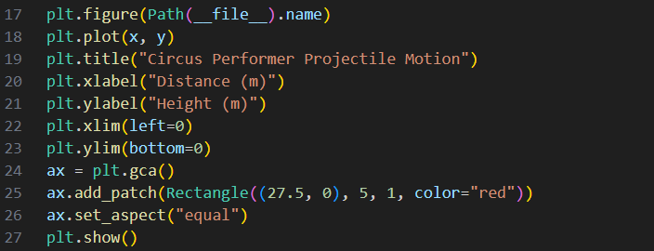
View projectile_motion.py
①
②
③
④
Trampoline = 5m x 1m

Slide 9
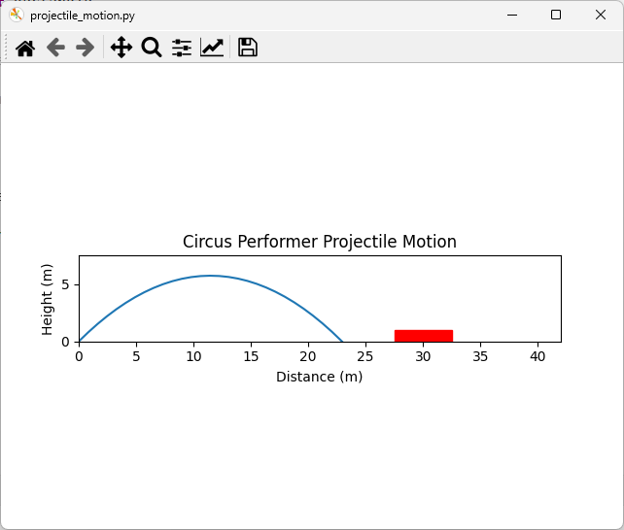
Run projectile_motion.py
What must be the initial velocity of the performer to land safely on the trampoline?
SPLAT!

Slide 10
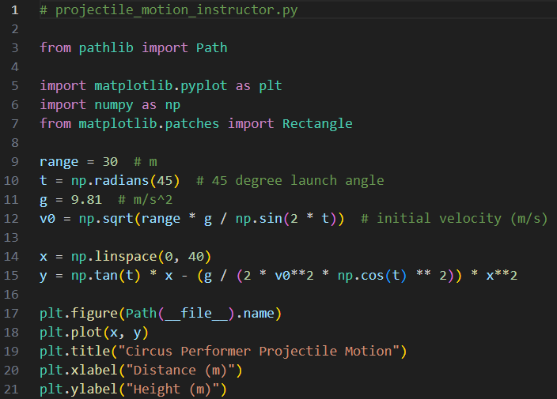
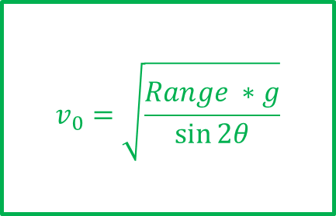
Edit projectile_motion.py
①

Slide 11

Run projectile_motion.py
SAFE!

Slide 12
Modelling Nuclear Decay
$N\left(t\right)≡$ number of nuclei at time t
$τ≡$ mean lifetime (half life)
$$\frac{dN}{dt}=−\frac{N(t)}{τ}$$
Fermat's Difference Quotient
$$\frac{dN}{dt}=\frac{N\left(t+Δt\right)−N(t)}{Δt}$$
$$−\frac{N(t)}{τ}=\frac{N\left(t+Δt\right)−N(t)}{Δt}$$
$$N\left(t+Δt\right)=N\left(t\right)−\frac{N(t)}{τ}Δt$$
This is Euler’s Method

Slide 13
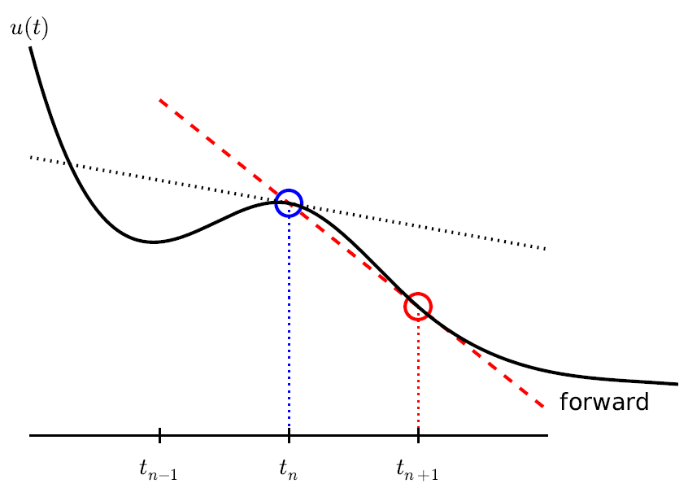
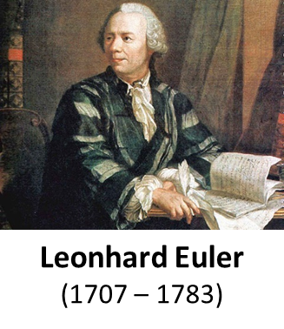
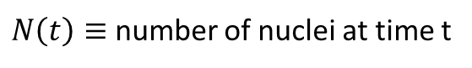
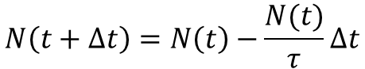
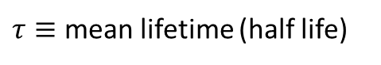
Modelling Nuclear Decay
$N\left(t\right)≡$ number of nuclei at time t
$τ≡$ mean lifetime (half life)
$$N\left(t+Δt\right)=N\left(t\right)−\frac{N(t)}{τ}Δt$$
This is Euler’s Method

Slide 14
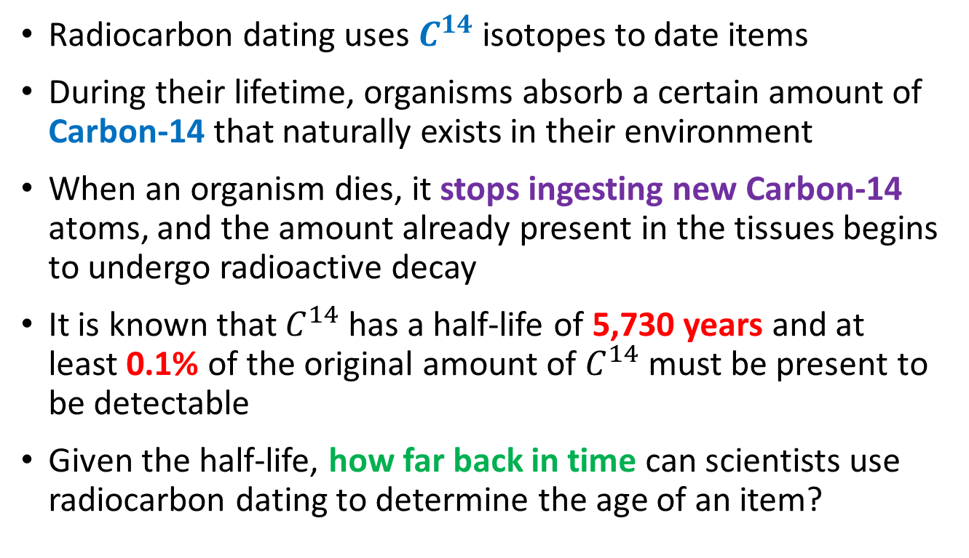
Modelling Carbon-14 Decay
Radiocarbon dating uses $C^{14}$ isotopes to date items
During their lifetime, organisms absorb a certain amount of Carbon-14 that naturally exists in their environment
When an organism dies, it stops ingesting new Carbon-14 atoms, and the amount already present in the tissues begins to undergo radioactive decay
It is known that $C^{14}$ has a half-life of 5,730 years and at least 0.1% of the original amount of $C^{14}$must be present to be detectable
Given the half-life, how far back in time can scientists use radiocarbon dating to determine the age of an item?

Slide 15
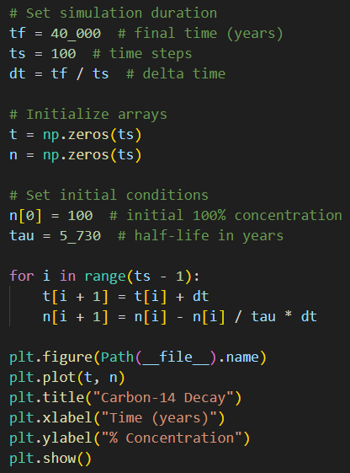
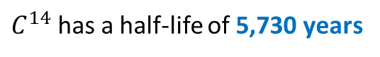
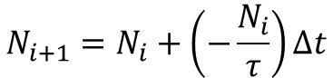
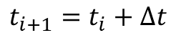
Open carbon14_decay.py
①
②
③
④
⑤
⑥
$C^{14}$ has a half-life of 5,730 years
⑦
⑧
$$t_{i+1}=t_{i}+Δt$$
⑨
$$N_{i+1}=N_{i}+\left(−\frac{N_{i}}{τ}\right)Δt$$
⑩

Slide 16
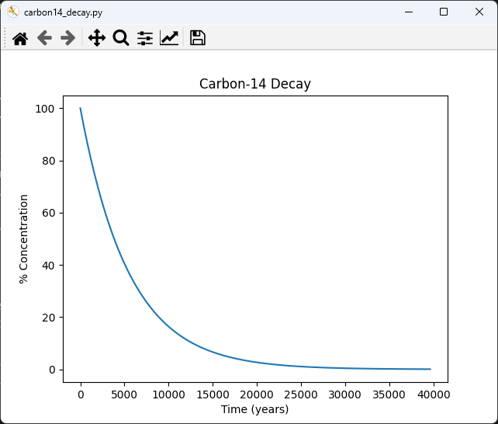
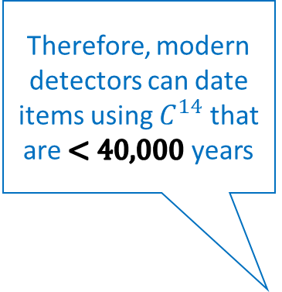
Run carbon14_decay.py
Therefore, modern detectors can date items using $C^{14}$ that are $<40,000$ years
At least 0.1% of the absorbed Carbon-14 must be present to be detectable

Slide 17
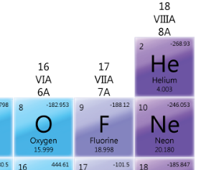
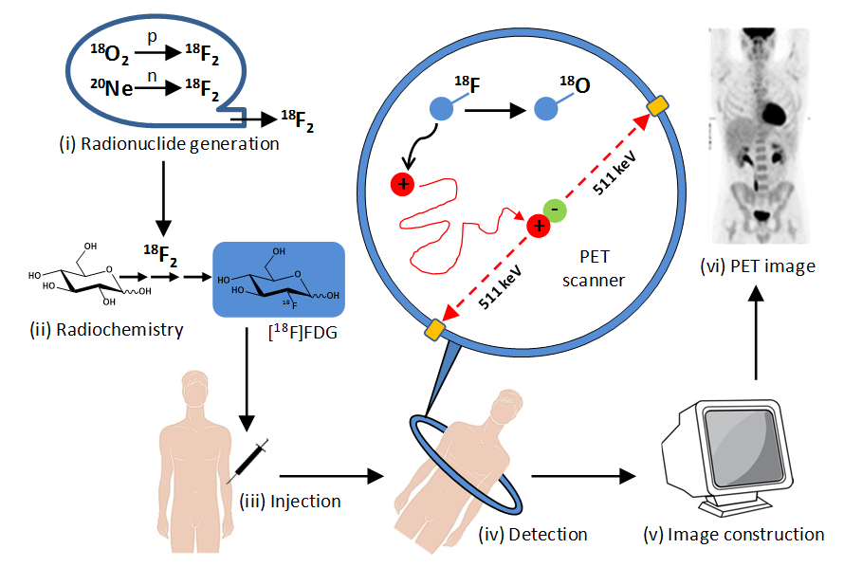
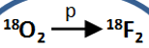

Fluorine-18
At least 5% of the injected Flourine-18 must still be present to be detected

Slide 18
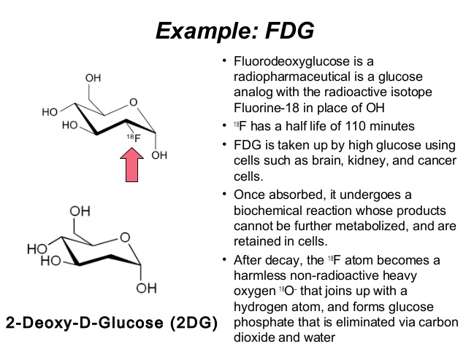
Fluorine-18

Slide 19
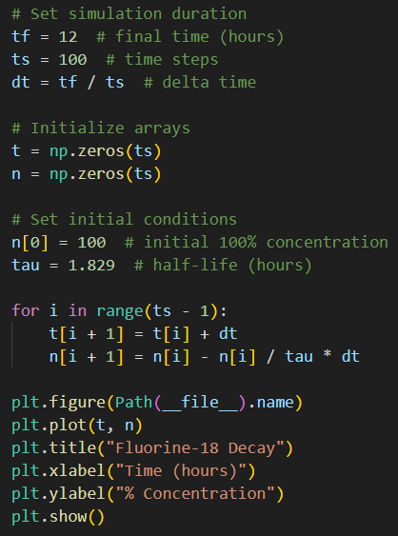
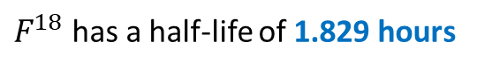
Open fluorine18_decay.py
①
②
③
④
⑤
⑥
$F^{18}$ has a half-life of 1.829 hours
⑦
⑧
$$t_{i+1}=t_{i}+Δt$$
⑨
$$N_{i+1}=N_{i}+\left(−\frac{N_{i}}{τ}\right)Δt$$
⑩

Slide 20
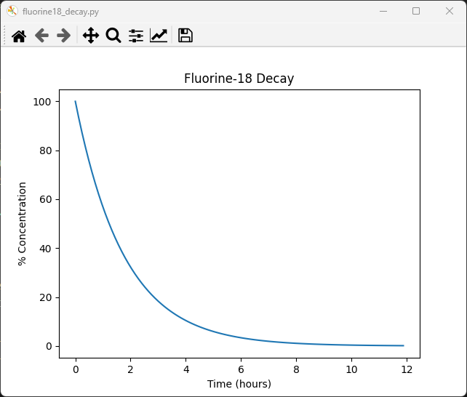
Run fluorine18_decay.py
What two key concepts does this graph suggest?
After 12 hours the ingested Fluorine-18 has decayed enough to not be a lingering threat
Medical staff must get patients into the PET scan within ~5 hours after taking Fluorine-18
At least 5% of the injected Flourine-18 must still be present to be detected

Slide 21
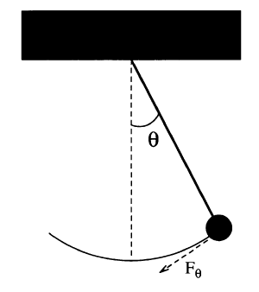
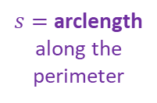
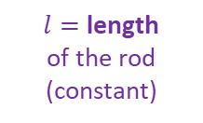
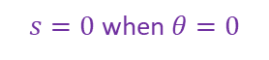
Modelling a Simple Pendulum
Gravity is a restoring force
$$F_{θ}=−mg\sin{θ}$$
$$l$$
$l=$ length
of the rod (constant)
$$ml\frac{d^{2}θ}{dt^{2}}=−mg\sin{θ}$$
$s=$ arclength along the perimeter
But Euler’s Method works only on first order ODEs! ☹
$$\frac{d^{2}θ}{dt^{2}}=−\frac{g}{l}\sin{θ}$$
$s=0$ when $θ=0$
$$s=lθ$$
$$F=ma$$
$$\frac{dω}{dt}=−\frac{g}{l}\sin{θ}$$
Take 2nd derivative of both sides with respect to time
We can break the 2nd order ODE into two linked first-order ODEs and use Euler’s method on each
$$F=m\frac{d^{2}s}{dt^{2}}$$
$$\frac{dθ}{dt}=ω$$
$$\frac{d^{2}s}{dt^{2}}=l\frac{d^{2}θ}{dt^{2}}$$
$$F_{θ}=ml\frac{d^{2}θ}{dt^{2}}$$

Slide 22
Modelling a Simple Pendulum
$$\frac{dω}{dt}=−\frac{g}{l}\sin{θ}$$
$$ω_{i+1}=ω_{i}−\frac{g}{l}\sin{θ_{i}}Δt$$
$$l$$
$$\frac{dθ}{dt}=ω$$
$$θ_{i+1}=θ_{i}+ω_{i}Δt$$
This is Euler’s Method
in time…

Slide 23
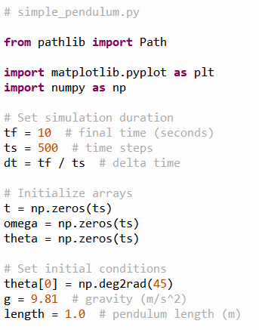

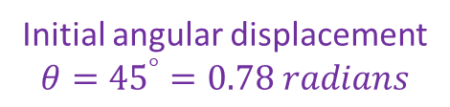
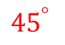
Open simple_pendulum.py
1m
①
$${45}^{°}$$
②
③
④
⑤
Initial angular displacement
$$θ={45}^{°}=0.78 radians$$
⑥
⑦
⑧
⑨

Slide 24
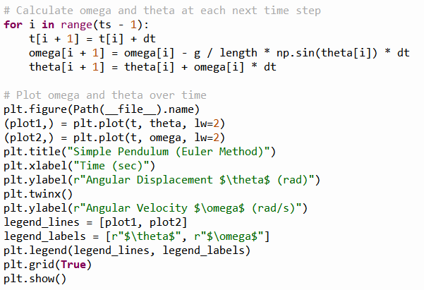

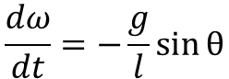
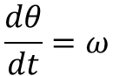
View simple_pendulum.py
This is Euler’s Method
①
②
$$\frac{dω}{dt}=−\frac{g}{l}\sin{θ}$$
③
$$\frac{dθ}{dt}=ω$$
④
⑤
⑥

Slide 25
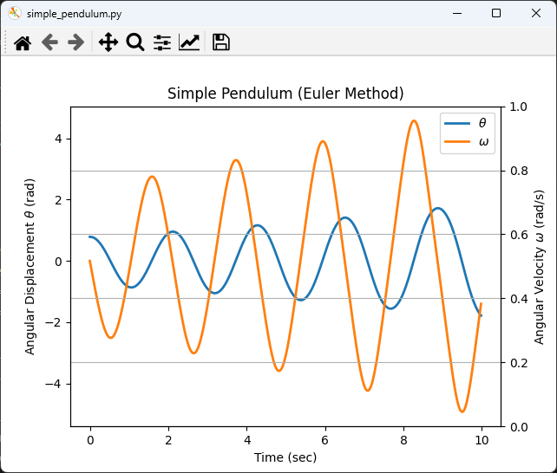
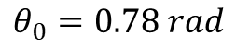
Run simple_pendulum.py
Initial pendulum angular displacement from centerline
$$θ_{0}=0.78 rad$$
This is not good… The model predicts the pendulum will begin to swing wildly, which would not happen naturally!

Slide 26
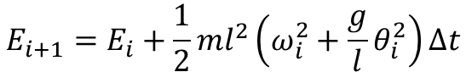
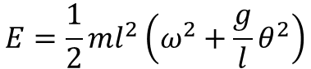
Numerical Instability of Euler's Method For Oscillatory Modes
kinetic
potential
Increasing the number of time steps by 10x does not prevent the displacement from growing after each oscillation
The simple forward Euler method can be unstable for harmonic motion
The energy in the system is artificially growing over time without bounds because no term can be negative
$$E=\frac{1}{2}ml^{2}ω^{2}+mgl(1−\cos{θ})$$
$$\left(θ<{22}^{°},\cos{θ}≈1−\frac{θ^{2}}{2}\right)$$
Small angle identity
$$E=\frac{1}{2}ml^{2}\left(ω^{2}+\frac{g}{l}θ^{2}\right)$$
$$E_{i+1}=E_{i}+\frac{1}{2}ml^{2}\left(ω_{i}^{2}+\frac{g}{l}θ_{i}^{2}\right)Δt$$
Due to the squaring of values,
the next energy state will always be incorrectly higher than the previous energy state

Slide 27
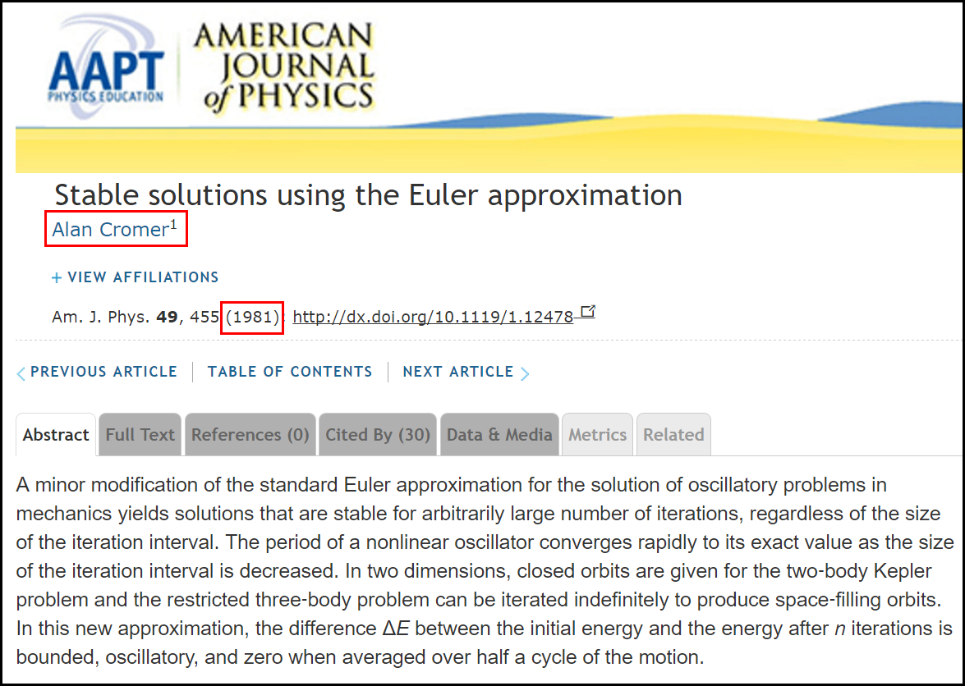


Cromer's Fix to Euler's Method

Slide 28




Edit simple_pendulum.py
Notice that the original ODEs don't change, just how we calculate them!
①
We must use the next value for $ω$, not the current value of $ω$
$$\frac{dω}{dt}=−\frac{g}{l}\sin{θ}$$
The
Euler-Cromer
Method
$$\frac{dθ}{dt}=ω$$

Slide 29

Run simple_pendulum.py
This simulation is now numerically stable
What is the physics story at these circled times?

Slide 30
Runge-Kutta Methods
Around 1900, two German mathematicians, Carl Runge and Wilhelm Kutta, wanted to improve the accuracy of Euler's Method
Following the same motivation underlying Simpson's Rule for numerical integration, they developed a method of interpolating a curve between the endpoints of a sampled interval
Using a weighted combination of tangent lines sampled throughout an interval, a more accurate derivative can be calculated than using the single tangent line in Euler's Method

Slide 31




Runge-Kutta Methods

Slide 32

Nonlinear Ordinary Differential Equation
Nowadays, High School Math Students are Doing Differential Equations

Slide 33











Nonlinear Ordinary Differential Equation
$$\frac{dy}{dx}=y∙\cos{x} y\left(0\right)=1$$
$$\ln{y}=\sin{x}+c$$
$$y=ce^{\sin{x}}$$
$$\left(\frac{1}{y}\right)\frac{dy}{dx}=\cos{x}$$
Initial Value
$$y\left(0\right)=1→c=1$$
$$\int{\frac{1}{y}ⅆy}=\int{\left(\cos{x}\right)ⅆx}$$
Solution:
$$y=e^{\sin{x}}$$
Check
$$\ln{y}+c=\sin{x}+c$$
$$\frac{d}{dx}\left(e^{\sin{x}}\right)=\frac{d}{du}\left(e^{u}\right)\frac{du}{dx} ,u=\sin{x}$$
$${=e}^{\sin{x}}\left(\frac{d}{dx}\left(\sin{x}\right)\right)$$
$$=e^{\sin{x}}∙\cos{x}$$

Slide 34




Open nonlinear_ode.py
①
$$\frac{dy}{dx}=y∙\cos{x}$$
②
③
④
⑤
⑥
⑦
$y_{1}→$ Euler’s Method
$y_{2}→$ Runge-Kutta Method
⑧

Slide 35

View nonlinear_ode.py
①
②
③
④
⑤
⑥
RK4 = 4th Order
Runge-Kutta Method
⑦

Slide 36

Run nonlinear_ode.py
Euler's Method continues to lose accuracy each iteration

Slide 37
Run nonlinear_ode.py
RK4 is stable and more accurate than Euler’s Method

Slide 38

Runge-Kutta Methods

Slide 39



Hidden Figures, Fox 2000 Pictures, 2016
Runge-Kutta Method

Slide 40
Solve ODEs with SciPy
We often must numerically solve systems of differential equations so we can simulate dynamic models
The Python package SciPy contains several ready-to-use numerical methods to estimate the solution to a variety of differential equations
Ordinary and Partial Differential Equations (ODE/PDE)
Linear and Non-Linear Differential Equations
Initial Value Problem (IVP) and Boundary Value Problems (BVP)
Both Individual and Systems of Linked Differential Equations

Slide 41

Scientific Computing with Python
https://scipy.org

Slide 42


Scientific Computing with Python

Slide 43

Modelling a Simple Pendulum
Gravity is a restoring force
$$F_{θ}=−mg\sin{θ}$$
$$l$$
$l=$ length
of the rod (constant)
$$ml\frac{d^{2}θ}{dt^{2}}=−mg\sin{θ}$$
$s=$ arclength along the perimeter
$\frac{g}{l}=$ Phase Constant
$$\frac{d^{2}θ}{dt^{2}}=−\frac{g}{l}\sin{θ}$$
$s=0$ when $θ=0$
$$s=lθ$$
$$F=ma$$
$$\frac{dω}{dt}=−\frac{g}{l}\sin{θ}$$
Take 2nd derivative of both sides with respect to time
We can break the 2nd order ODE into two linked first-order ODEs and use Euler’s method on each
$$F=m\frac{d^{2}s}{dt^{2}}$$
$$\frac{dθ}{dt}=ω$$
$$\frac{d^{2}s}{dt^{2}}=l\frac{d^{2}θ}{dt^{2}}$$
$$F_{θ}=ml\frac{d^{2}θ}{dt^{2}}$$

Slide 44






Open scipy_pendulum.py
$$\frac{d^{2}θ}{dt^{2}}=−\frac{g}{l}\sin{θ}$$
①
②
③
④
⑤
⑥
$$\frac{dω}{dt}=−\frac{g}{l}\sin{θ}$$
Our 2nd order ODE does not contain a $t$ (time) term
$\frac{g}{l}=$ Phase Constant
$$\frac{dθ}{dt}=ω$$
We return derivative values in the same order they are unpacked from the state_vector

Slide 45

View scipy_pendulum.py
①
②
Released from rest
③
④
⑤
⑥
⑦
⑧
⑨
Trailing comma makes it a tuple versus a scalar in parenthesis
⑩

Slide 46

View scipy_pendulum.py
①
②
③
④
⑤
⑥
The plt.twinx() function in Matplotlib creates a secondary y-axis that shares the same x-axis with the primary y-axis. This allows you to plot two datasets on the same plot with two different y-axes

Slide 47

Run scipy_pendulum.py

Slide 48
Damped Harmonic Oscillator
In real-world oscillators, friction (or damping) slows the system’s motion. Due to frictional force, the velocity decreases in proportion to the acting frictional force
In contrast to a simple undriven harmonic oscillator (where the only force acting on the mass is the restoring force), in a damped harmonic oscillator there is an additional frictional force that always acts in the direction opposing the motion
Our goal is to create mathematical models that mirror reality as closely as possible. Friction, a ubiquitous force in the real world, is a crucial element that should never be overlooked in any rigorous simulation

Slide 49


Damped Harmonic Oscillator
$$\frac{d^{2}θ}{dt^{2}}=−\frac{g}{l}\sin{θ}$$
$\frac{g}{l}=$ The phase constant
We can introduce a new resistive force term into the equation of motion for a pendulum
$$\frac{d^{2}θ}{dt^{2}}=−q\frac{dθ}{dt}−\frac{g}{l}\sin{θ}$$
$q$= The damping constant
$$\frac{dω}{dt}=−qω−\frac{g}{l}\sin{θ}$$
$$\frac{dθ}{dt}=ω$$

Slide 50


Damped Harmonic Oscillator
Underdamped – The system swings back and forth (oscillates) over its equilibrium point, but ultimately comes to rest
Example: $q=1$
Overdamped – The system never oscillates, but it takes a while for it to return to its equilibrium point
$$\text{Example}\text{:} q=\frac{{\left(phase constant\right)}^{2}}{2}$$
Critically damped – The system never oscillates and returns to its equilibrium point in the least amount of time
$$q=\frac{{\left(phase constant\right)}^{2}}{4}$$
Note: There is only one value for $q$ where the system is critically damped

Slide 51



Open damped_pendulum.py
①
②
③
④
⑤
③
④

Slide 52

View damped_pendulum.py
①
②
③
④
⑤

Slide 53



View damped_pendulum.py
①
②
③
④
⑤
⑥
⑦

Slide 54


View damped_pendulum.py
$$\frac{d^{2}θ}{dt^{2}}=−q\frac{dθ}{dt}−\frac{g}{l}\sin{θ}$$
①
②
③
④
⑤

Slide 55

Run damped_pendulum.py
In what applications would you want a system to be critically damped?

Slide 56

Damped Harmonic Oscillator

Slide 57


Tuned Mass Dampers
Taipei 101 – Taiwan
The Worlds Tallest Building (2004-2009)
730 Tons

Slide 58

Tuned Mass Dampers
365 Minivans

Slide 59

Coupled Harmonograph

Slide 60


Coupled Harmonograph
Each pendulum controls the X or Y displacement

Slide 61



Open harmonograph.py
①
②
③
④
⑤
⑥
⑦
⑧
⑨

Slide 62

View harmonograph.py
①
The adaptive step size control used in methods like 'RK45' dynamically adjusts the step size to maintain the error within specified tolerances, especially
in regions where the solution changes rapidly
②
③
④
⑤

Slide 63


View harmonograph.py
①
We plot the dependent variable values (theta) of both curves
against each other
We don’t include the
independent variable time
This visualizes the “tug of war” between the two pendulums pulling on the shared pen drawing the curve

Slide 64


Run harmonograph.py
$$l_{1}≠l_{2}$$
$$θ_{1i}=θ_{2i}$$
$$ω_{1i}=ω_{2i}$$

Slide 65


Lissajous Figures

Slide 66

Lissajous Orbits

Slide 67

Lissajous Orbits
Lagrange Point
Lagrange Point

Slide 68

Lissajous Orbits
A Halo Orbit

Slide 69



Slide 70

Estes Model Rocket
This Estes Model Rocket has two stages, with each stage containing its own Estes F15 rocket motor
After the 1st (booster) stage is ignited, the rocket will blast off and begin to rise using just the booster motor
After the 1st stage motor burns out, the booster stage (with its spent motor) is ejected, the 2nd stage F15 motor ignites, and the rocket continues to ascend
The 2nd stage and its motor remain part of the rocket throughout the duration of the flight
Stage 2
Stage 1

Slide 71
Estes Model Rocket
The Stage 1 booster has a mass of 0.0519 kg (not including its F15 motor)
The Stage 2 main rocket has a mass of 0.1729 kg (not including its F15 motor)
An Estes F15 rocket motor has a mass of 0.101 kg, generates a thrust of 17.2 Newtons, and burns for 1.6 seconds
For this simulation, we will assume the thrust of a motor is constant throughout its burn, assume there is no delay between the ejection of the booster and the ignition of the Stage 2 motor, and ignore air friction
Stage 2
Stage 1

Slide 72







Estes Model Rocket
We must model the trajectory of the rocket over the first four seconds of its flight: from liftoff to booster separation and into its unpowered glide phase
We want to calculate the rocket’s expected velocity (mph) and altitude (feet) over time (seconds) and determine its average speed and maximum height through four seconds
We will assume the mass of each motor reduces linearly throughout its burn (100% of mass at ignition and 0% of mass at moment of burnout)
The force of gravity resisting the rocket is:
$$F_{g}=\frac{G×M_{E}×m}{{\left(R+h\right)}^{2}}$$
$$G=Gravitatinal Constant$$
$$m=Mass of rocket$$
$$M_{E}=Mass of Earth$$
$$h=Height of rocket$$
$$R=Radius of Earth$$

Slide 73

Open estes_rocket.py
①
②
③

Slide 74

View estes_rocket.py
①
Once the elapsed time since liftoff exceeds the burn time of both motors, there is no longer any thrust
②
③
④
⑤
⑥
⑦
⑧
⑨
2nd Stage Motor has no mass from unburnt fuel

Slide 75



View estes_rocket.py
①
②
v = velocity
h = height (alt)
③
④
⑤
⑥
$$F=ma$$
⑦
$$s=vt$$
⑧

Slide 76
View estes_rocket.py
①
②
③
④
⑤

Slide 77

View estes_rocket.py
①
②
③
④
⑤

Slide 78

Run estes_rocket.py
Linear?
Non-linear
Non-linear

Slide 79
Session 17 – Part 2 of 2 – Topics
Solve coupled non-linear ODEs to model predator-prey dynamics
Visualize the S-I-R compartment model used in epidemiology to model the spread over time of infectious disease across a population
Model the electrostatic field around the charged parallel plates inside a capacitor where the surrounding walls are conductors (fixed potential) or insulators (fixed charge)
Numerically estimate solutions to the Laplace 2nd order partial differential equation using both Neumann and Dirichlet boundary conditions
Use a convolution kernel (a stencil) to perform Jacobi relaxation over a discretized grid

Slide 80



Predator-Prey Modelling
https://en.wikipedia.org/wiki/Lotka-Volterra Equations
1925
Visualize the Lotka-Volterra differential equations
with these characteristics & initial conditions:
$$α=2, β=1.1, γ=1.0, δ=0.9$$
$$x\left(0\right)=1, y\left(0\right)=0.5$$
In this model, at any time$t$ :
$x\left(t\right)$ represents the prey population
$y\left(t\right)$ represents predator population
Alfred Lotka
$α=$ Prey Birth Rate
$β=$ Prey Death Rate
$γ=$ Pred Death Rate
$δ=$ Pred Birth Rate
The solution to their system of coupled non-linear 1st order differential equations can be numerically estimated using the scicpy solve_ivp function
Vito Volterra

Slide 81



Open predator_prey.py
$x\left(t\right)=$ prey population
$y\left(t\right)=$ predator population
$α=2.0$ Prey Birth Rate
$β=1.1$ Prey Death Rate
$γ=1.0$ Pred Birth Rate
$δ=0.9$ Pred Death Rate
①
②
③
④

Slide 82



View predator_prey.py
At time$t$ :
$x\left(t\right)=$ prey population
$y\left(t\right)=$ predator population
①
$α=2.0$ Prey Birth Rate
$β=1.1$ Prey Death Rate
$γ=1.0$ Pred Birth Rate
$δ=0.9$ Pred Death Rate
②
③
④
Once created, tuples are immutable
$$x\left(0\right)=1, y\left(0\right)=0.5$$
This array will hold the solution values
⑤
⑥

Slide 83

View predator_prey.py
①
②
③
④
③
④

Slide 84

Run predator_prey.py
What story is this graph telling?

Slide 85


Epidemiological Modeling
Based upon the pioneering work of Hudson and Ross, the Kermack-McKendrick (1933) S-I-R equations model the spread of infectious diseases throughout a population
$S(t)$ = Susceptible population
$I(t)$ = Infected population
$R(t)$ = Recovered population
$β=$ Infection rate factor
$δ=$ Recovery rate factor
Hilda Hudson
As time progresses, the population changes from one compartment to the next: $S→I→R$
Note: the total population in this model does not change
$$\frac{ⅆS}{ⅆt}=−βSI$$
$$\frac{ⅆI}{ⅆt}=βSI−δI$$
$$\frac{ⅆR}{ⅆt}=δI$$
Ronald Ross
We seek the functions $S\left(t\right), I\left(t\right),and R(t)$

Slide 86


Epidemiological Modeling
$β=$ Infection rate factor
$δ=$ Recovery rate factor
As people become infected, the susceptible population decreases
As more people are infected, the faster the disease is spread to the susceptible
$$\frac{ⅆS}{ⅆt}=−βSI$$
William Kermack
Having more susceptible people makes it easier for the infection to find a new host
Susceptible people become infected (𝜷) and infected people become recovered ($δ$)
$$\frac{ⅆI}{ⅆt}=βSI−δI$$
The number of recovered people increases over time
$$\frac{ⅆR}{ⅆt}=δI$$
Anderson McKendrick

Slide 87




Open epidemiology.py
$β=$ Infection rate factor
$δ=$ Recovery rate factor
$$\frac{ⅆS}{ⅆt}=−βSI$$
$$\frac{ⅆI}{ⅆt}=βSI−δI$$
$$\frac{ⅆR}{ⅆt}=δI$$
r does not appear in the differential equations
①
②
③
④

Slide 88



View epidemiology.py
①
②
④
Recovery Rate $≫$ Infection Rate
③
④
⑤
Only $1$ person is sick at the start
⑥
⑦

Slide 89

View epidemiology.py
①
②
③

Slide 90

Run epidemiology.py
What story is this graph telling?

Slide 91

S-I-R Model Epidemiology
The infected population will fall more slowly than it rises, hence it takes much longer to rid a population of an infection than it takes for the initial infection to spread
A percentage of people will remain susceptible for a very long time - hence the need for an ongoing vaccination program – think about smallpox, polio, etc.
I first made these slides in 2016 – before COVID-19 ☹
Mathematics doesn’t care about your politics

Slide 92


Slide 93

Electrostatic Field in Parallel Plates

Slide 94

Electrostatic Field in Parallel Plates

Slide 95


Electrostatic Fields
$$Coulomb^{′}s Law$$
$$F∝\frac{q_{1}q_{2}}{r^{2}}⟹F=k\frac{q_{1}q_{2}}{r^{2}}$$
$$k=\frac{1}{4πε_{0}} (Coulomb^{′}s constant)$$
$$F=\frac{q_{1}q_{2}}{4πε_{0}r^{2}}$$
$q=$ Electric charge
$ℰ_{0}=$Permittivity of free space
Electric Potential (Voltage)
$$E=\frac{q_{1}q_{2}}{4πε_{0}}\left[\frac{1}{r_{A}}−\frac{1}{r_{B}}\right]$$
$$W_{A→B}=\int_{A}^{B}{Fⅆs}$$
q2
B
A
A as reference point $∴$ $r_{B}=∞$
$$E\left(r\right)=\frac{q_{1}q_{2}}{4πε_{0}}\int_{A}^{B}{\frac{1}{r^{2}}ⅆr}$$
q1
$$E_{A}=\frac{q_{1}q_{2}}{4πε_{0}r_{A}}$$
$$\int{\frac{1}{r^{2}}=−\frac{1}{r}}$$
$$\frac{−1}{r_{B}}−\frac{−1}{r_{A}}=\frac{1}{r_{A}}−\frac{1}{r_{B}}$$

Slide 96

Electric Field Potential Between Charges
Electric Potential (V)
A scalar field
Electric Field (V/m)
A vector field
?

Slide 97





Electrostatic Field in Parallel Plates
$∇ ≡$ gradient (del) operator (nabla)
$ρ=$ charge density
$ϵ_{0}=$ electric field permittivity
Gauss's Law for Electric Fields – Electric fields diverge from positive charges and converge on negative charges
$∇∘\vec{E}=\frac{ρ}{ϵ_{0}}$
$$\vec{E}=−∇V$$
The negative sign indicates that the electric field points towards a decreasing potential
Physically, this means that a positive charge will naturally move from regions of higher potential to regions of lower potential
$∇\vec{E}=0$ for an electrostatic field (the field isn’t changing)
$$∇\vec{E}=0→∇\left(−∇V\right)=0→∇^{2}V=0$$

Slide 98









Electrostatic Field in Parallel Plates
$$∇^{2}V=0$$
For a function to be static, it is not enough for the first derivative to be zero – think of the pendulum at the far left or right of its swing…
Its 2nd derivative must also be zero!
$$∇^{2}V=\frac{∂^{2}V}{∂x^{2}}+\frac{∂^{2}V}{∂y^{2}}=0$$
2D Continuous
Discretization
over a 2D Grid
$$V_{i,j}→\frac{1}{4}\left(V_{i+1,j}+V_{i−1,j}+V_{i,j+1}+V_{i,j−1}\right)=0$$
$$i−1$$
$$i$$
$$i+1$$
$$j−1$$
+
$$j$$
+
c
+
$$j+1$$
+

Slide 99

Electrostatic Field in Parallel Plates
$$∇^{2}V=0$$
For a function to be static, it is not enough for the first derivative to be zero – think of the pendulum at the far left or right of its swing…
Its 2nd derivative must also be zero!
$$∇^{2}V=\frac{∂^{2}V}{∂x^{2}}+\frac{∂^{2}V}{∂y^{2}}=0$$
2D Continuous
Discretization
over a 2D Grid
$$V_{i,j}→\frac{1}{4}\left(V_{i+1,j}+V_{i−1,j}+V_{i,j+1}+V_{i,j−1}\right)=0$$
A convolution kernel (stencil)
$$\left[\begin{matrix}0 & 1/4 & 0 \\ 1/4 & 0 & 1/4 \\ 0 & 1/4 & 0\end{matrix}\right]$$

Slide 100
Electrostatic Field in Parallel Plates
If we apply the convolution of the kernel to successive overlapping 3 x 3 swatches of the field grid (across both the x and y dimensions), we will find the “next in time” value of the electric field for each point in the grid
A convolution involves multiplying each cell in the 3 x 3 kernel with the corresponding cell in the current swatch location (within the grid) and then summing those nine products
We convolve the entire 2D field grid with the kernel enough times to ensure every “next in time” grid cell value is equal to its “prior in time” grid cell value – meaning there is no change over time
When this condition is realized, we have reached a steady state and therefore have an electrostatic field. This iterative approach is called the Jacobi Relaxation Method

Slide 101
Electrostatic Field in Parallel Plates
With ordinary differential equations (ODEs), we must specify the initial conditions for an exact solution. We must specify boundary conditions with partial differential equations (PDEs)
In our simulation of the electrostatic field around parallel plates, we have two choices for boundary conditions:
Neumann boundary conditions: the plates are surrounded by walls of conductors, thus preventing any electric potential from building up along the walls, so the cells around the outermost edges of the grid are forced to maintain the same field strength as their neighboring cells. This makes a zero gradient along the walls
Dirichlet boundary conditions: the plates are surrounded by walls of insulators, thus preventing any electric charge from building up along the walls, so the cells around the outmost edges of the grid are forced to maintain a zero voltage

Slide 102



Open parallel_plates.py
①
②
③

Slide 103

View parallel_plates.py
①
②
③

Slide 104



View parallel_plates.py
①
②
Left plate at -1 Volts
Right plate at +1 Volts
③
Discretize over a $\left(100×100\right)$ grid
④
Each plate is 1 column wide by 40 rows high, separated by 40 columns
⑤
Boolean indexing
$$\left[\begin{matrix}0 & 1/4 & 0 \\ 1/4 & 0 & 1/4 \\ 0 & 1/4 & 0\end{matrix}\right]$$
⑥

Slide 105

View parallel_plates.py
①
②
③
④
⑤
⑥
Zero-padding: The input grid is extended with zeros beyond its boundaries before the convolution operation. This padding ensures that the kernel can overlap with all elements of the input grid, even those near the edges
Output size: The constant mode ensures the output grid is the same as the input grid
Convolution operation: The kernel slides over the extended input grid, computing the dot product at each input grid position

Slide 106

View parallel_plates.py
①
②
③
A function name has an intrinsic value
④
⑤
We are modeling a square grid

Slide 107

Run parallel_plates.py

Slide 108

Edit parallel_plates.py

Slide 109

Edit parallel_plates.py

Slide 110

Session 17 – Now You Know…
How to develop the equations of motion to accurately plot the 2D trajectory of a projectile moving through a uniform gravitational field
Euler’s Method (forward-in-time step analysis) yields numeric solutions to differential equations
We can model 2nd order differentials by representing them as a chain of linked 1st order equations
Euler-Cromer is better when modelling harmonic oscillators
A higher-order approach like Runge-Kutta improves accuracy
Increasing the number of time steps (decreasing $∆t)$ improves the accuracy of the estimations but then requires more time to run

Slide 111
Session 17 – Now You Know…
The scipy package has many numerical solvers for systems of differential equations
Even a simple set of linked differential equations can yield highly complex long-term behavior of systems
Most dynamical systems have critical values that are related to its fundamental equilibrium points (consider the damping constant)
We can estimate solutions to systems of linked non-linear ODEs using the Runge-Kutta Method
The S-I-R epidemiology models have been greatly enhanced by modern research in computational biology
The language of all science is Differential Equations – please try to learn about them!

Slide 112

Task 17-01
Edit harmonograph.py to reproduce this ellipse:
Upload your solution to the BNL QIS102 SharePoint site

Slide 113


Task 18-02
Create a Python file called rlc_circuit.py
Your code should plot the current over time flowing through an RLC circuit that maintains a constant DC voltage
Use SciPy to estimate this 2nd order homogenous ODE out to 1 second in duration using these values
Upload your solution to the BNL QIS102 SharePoint site
$$\frac{d^{2}}{{dt}^{2}}I\left(t\right)=−\frac{R}{L}\frac{d}{dt}I\left(t\right)−\frac{1}{LC}I(t)$$
R = 0.1 Ohms
L = 0.01 Henries
C = 0.01 Farads
Initial I = 1 Amp

Slide 114

Task 18-02

